Slide 1
Proposed Changes to Cleveland's Air Code
David Hearne, Commissioner (216) 664- 2178 | dhearne@clevelandohio.gov​
Christina Yoka, Chief of Air Pollution Outreach ​ (216) 664- 2129 | cyoka@clevelandohio.gov​
Priya Govender, Health Outreach Specialist
(216) 420-7683 | pgovender@clevelandohio.gov

Slide 2
Use the tools at the top of the Teams window to interact
Raise your hand to let us know you have a question, or type your question into the chat!

Slide 3
Cleveland Division of Air Quality
Local air agency serving City of Cleveland and Cuyahoga County
Comprised of 4 Sections including Monitoring, Enforcement, Permitting and Outreach

Slide 4
Monitoring
Operates Air Monitoring Networking throughout Cuyahoga County
Enforcement
Permitting
Prepares permits for stationary sources of air pollution
Outreach
Ensures that industrial and commercial air pollution sources regulated by Ohio EPA are in compliance with applicable regulations
Engages residents in matters related to air quality and public health

Slide 5
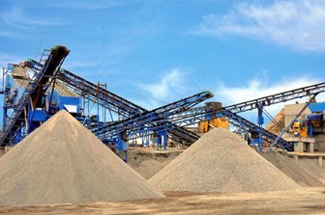
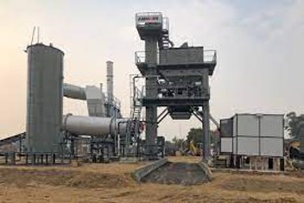
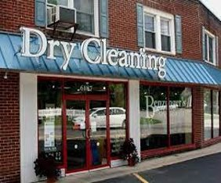
Types of industry that may produce air pollution and may be regulated
• Asphalt plants ​
• Auto body shops ​
• Crematories ​
• Dry cleaners ​
• Foundries ​
• Gas stations ​
• Grain elevators ​
• Furniture manufacturing ​
• Metal finishing/plating ​
• Plastics manufacturing ​
• Printing/graphic arts​
• Sand and gravel plants

Slide 6
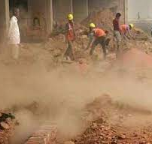
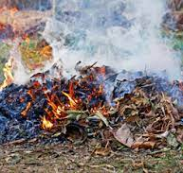
Air Quality Complaints
Asbestos
Fugitive Dust
Indoor Air Quality (Cleveland only)
Odors
Open Burning
Smoke
Other air related issues
(216) 664-7442
www.clevelandhealth.org

Slide 7
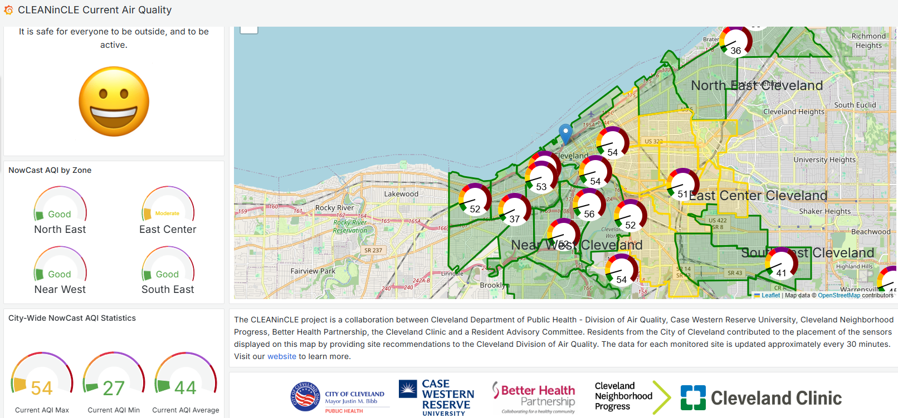
https://data.clevelandohio.gov/apps/7aa630d69e694fc69fe9f5cec709d8b7/explore

Slide 8
What is the Cleveland Air Code?
A set of rules passed by Cleveland City Council in 1977 that authorizes the Cleveland Division of Air Quality to regulate air pollution in the City of Cleveland
These rules are a part of the City of Cleveland Health Code
Will these changes impact the State and or Federal permits?
No, these rules will not have any impact on State or Federal permits. These are for City of Cleveland facilities only.
Why are we proposing changes to the Code?
There have not been any major changes since 1977 and a lot has changed
These proposed rules are meant to protect the health needs of today

Slide 9
Pediatric Asthma in Cleveland
National average: 8%
Cleveland Range: 5% - 25%
Cleveland was ranked 6th in the "Asthma Capitals"
2024 Report produced by the Asthma and Allergy Foundation

Slide 10
How did CDAQ develop this proposal?
We completed a technical review of the existing code and updated where necessary. (ex: Updated technology used for odor detection)
Organizational stakeholder meetings from April 2019 through September 2019 that included both industry and organizations serving community members.
CDAQ Outreach team tabling events: What concerns do we hear while talking to community members?
CLEANinCLE Proposal: Received 80 site recommendations from Cleveland residents. What concerns were expressed?
Technical support form US EPA
Air Quality Complaints from 2021 - 2024

Slide 11
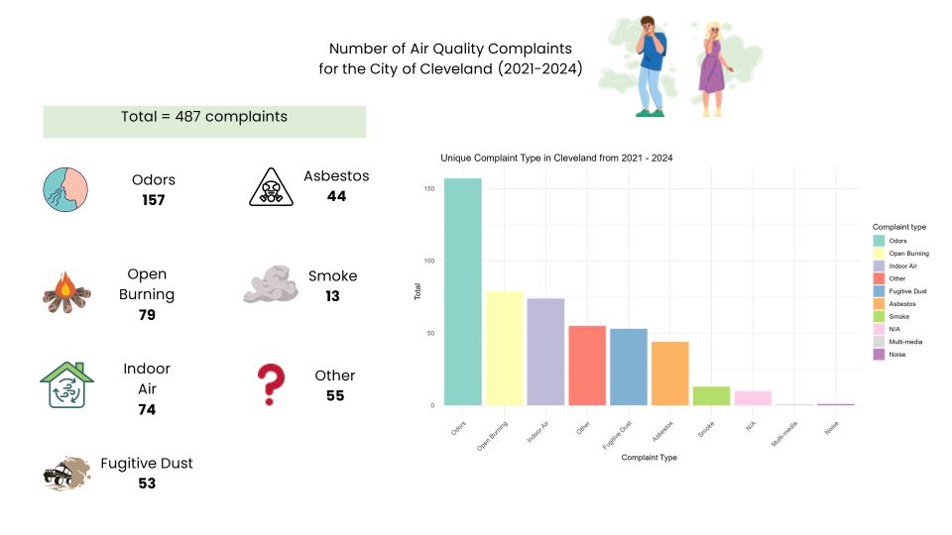

Slide 12
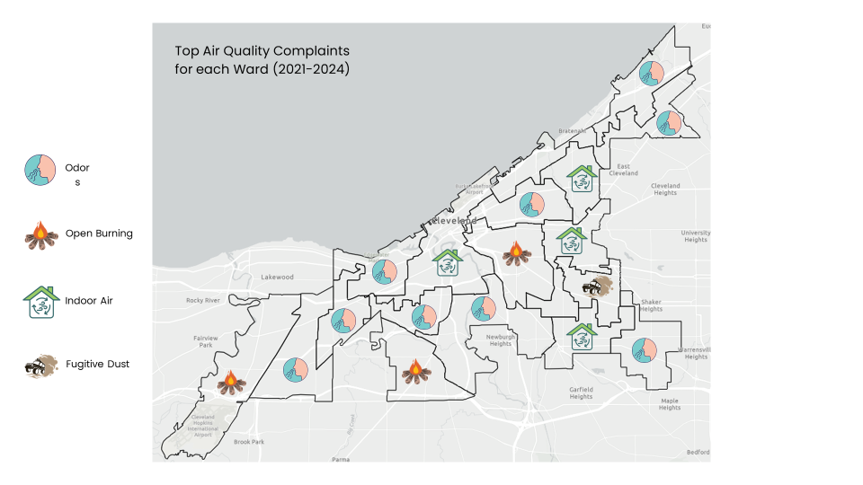

Slide 13
Questions?
10 Minutes

Slide 14
High Level Overview of Proposed Changes
This presentation is not inclusive of all the proposed changes. This is a high-level overview. The full proposal is available on our website at www.clevelandhealth.org. Today we will discuss the following:
Cumulative Impacts and Installation Permits
Installation and Modification Permits
Health Impact Assessments
Installation and Operation Fees
5. Emission Reduction and Mitigation Activities
6. Formally establish Indoor Air Quality program
7. Vehicle Idling
8. Emergency Episodes
This is a draft. Comments are welcome until 2/17/2025. ​After 2/17/2025, we will incorporate comments where able and then submit to Cleveland City Council for consideration in March.

Slide 15
What are "Cumulative Impacts?"
251.24 "Cumulative Impact “Cumulative Impact” means the adverse health impact or effect, risk, or nuisance from multiple pathways and multiple sources and also refers to the totality of exposures from combinations of pollutant source stressors from air pollution and non-pollutant source stressors that affect human health..."
What this means: We are looking at how multiple sources and stressors in an environment impact human health
How will this information be used: Industries located in high cumulative impact areas may have additional requirements

Slide 16
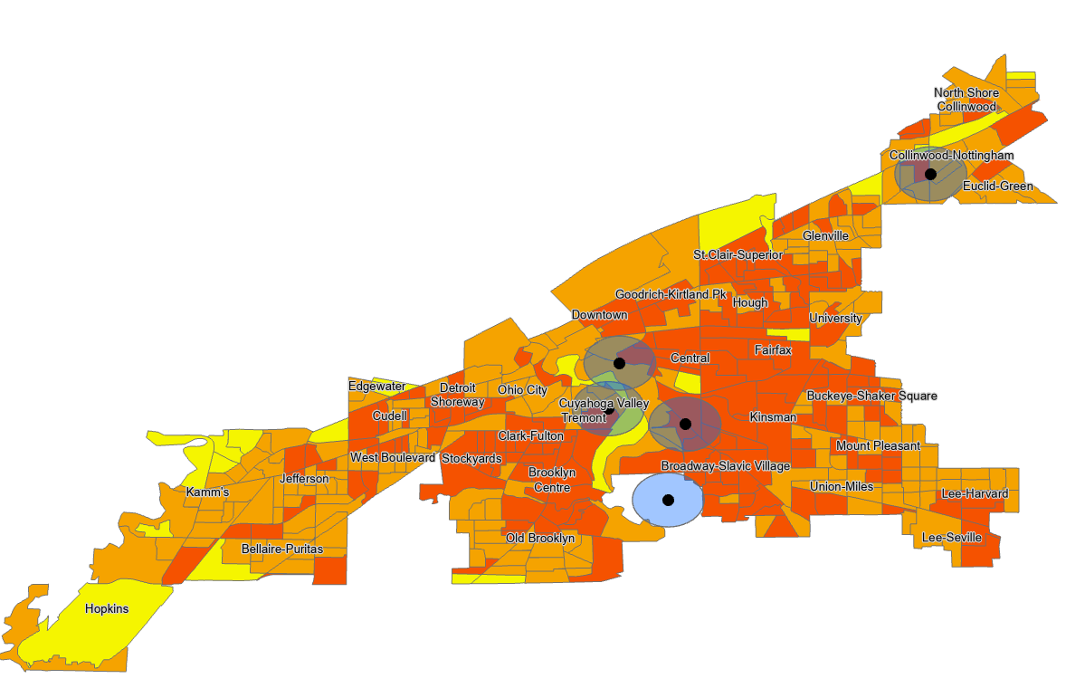
Cumulative Impacts Preliminary Map
1-4
5-7
>8

Slide 17
Feedback Instructions
After each slide, I am going to ask for feedback
If you mostly support the proposed change, raise your paddle with the green facing me
If you mostly oppose the proposed change, raise your paddle with the red facing me
If you are unsure (for whatever reason), do not lift your paddle
Why are we doing this?
This provides real time feedback on specific items in the short time that we have
This will help us understand if we are explaining the concepts well. We can make adjustments for future meetings.
Are there other ways for me to provide feedback?
Yes! We have hard copy feedback forms, a comment form on our website, and you can leave a voicemail at (216) 420-8049. More info on this later.

Slide 18
Cumulative Impacts and Installation Permits
Proposed Rule (New)
Every 5-years CDAQ will produce a health impact report documenting areas in Cleveland with the highest cumulative impact scores and relative health information
The cumulative impact score will be a relative system from 1 to 10 (10 has the heaviest impacts)
Why it matters
Increased reporting requirement of CDAQ
Documents where there are health concerns in the City of Cleveland
Documents change in health throughout neighborhoods
Identifies census tracts that have additional requirements for facilities
ThePhoto by PhotoAuthor is licensed under CCYYSA.
Draft Code Section: §257.01 Installation and Modification Permits

Slide 19
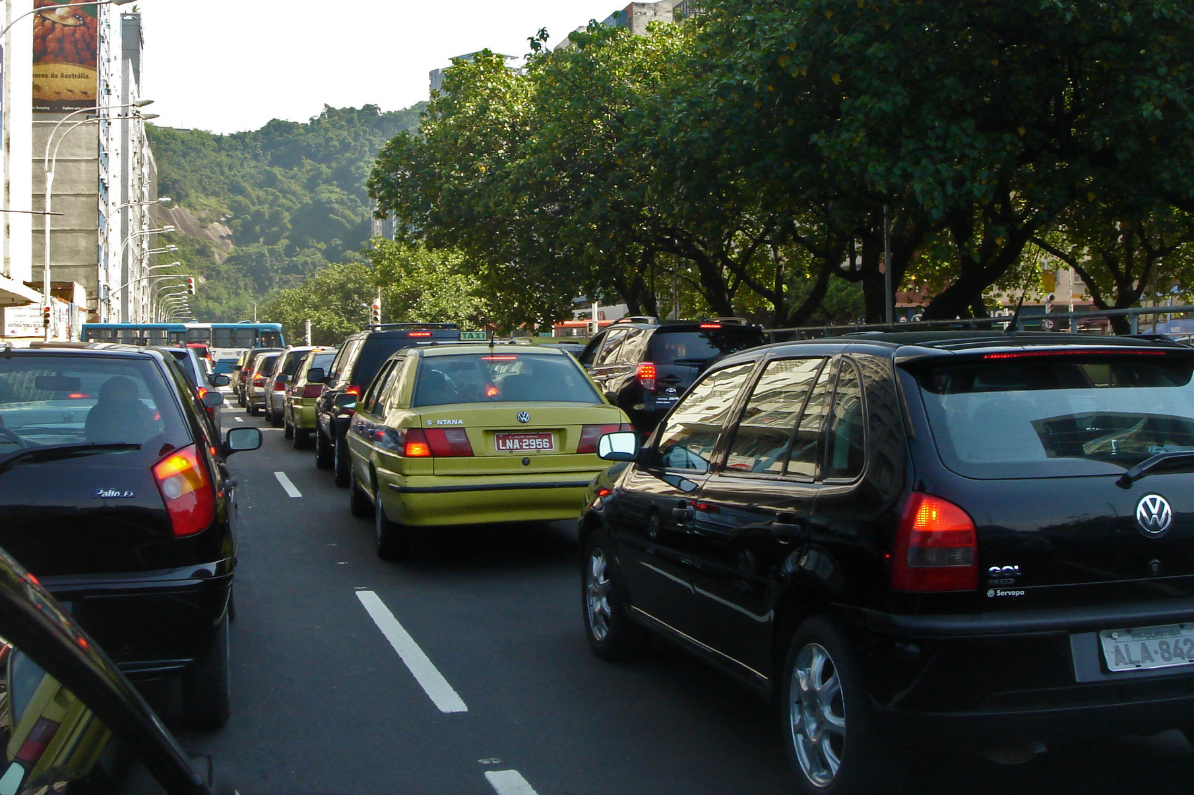
2. Installation and Modification Permits
Proposed Rule (New)
Facilities located in neighborhoods with CI scores of 8-10 will be required to submit additional information with their permit applications. The additional information will include vehicle traffic.
These forms will be publicly available.
Why it matters
This provides a more detailed understanding of neighborhood air pollution in vulnerable communities
This information helps to craft neighborhood specific pollution reduction strategies
Greater transparency on industry operations with community members
ThePhoto by PhotoAuthor is licensed under CCYYSA.
Draft Code Section: §257.01 Installation and Modification Permits

Slide 20
3. Health Impact Assessments
Proposed Rule (New)
Facilities located in neighborhoods with CI scores of 10 AND that meet the criteria for synthetic minor, FEPTIO, and Title V status will be required to submit a Health Impact Assessment for all new and modified sources.
The Health Impact Assessment must include a comprehensive community engagement plan and appropriate air modeling of pollutants
Why it matters
Synthetic minors, FEPTIOs, and Title V facilities are the larger emitting facilities. Community members will be engaged in any potential changes and the health impact assessment will identify where they may be adverse affects on the community.
Community members will be engaged in the process and a part of strategies to reduce the impact
Draft Code Section: §257.01 Installation and Modification Permits

Slide 21
4. Installation and Operation Fees
Proposed Rule (New)
Installation Fees: CDAQ is currently authorized to invoice for double the operation fee. We are finalizing the installation fee changes and welcome input on how this fee should be assessed.
Operation Fees: Operational fees are increasing. They have not been revised 2003.
Collected Fees will fund emission reduction and air pollution mitigation activities
Why it matters
Facilities will be impacted by the revised fee structures.
The collected fees will be used for projects that reduce the impact on air pollution in communities (more information on a later slide)
Draft Code Section: §257.01 Installation and Modification Permits

Slide 22
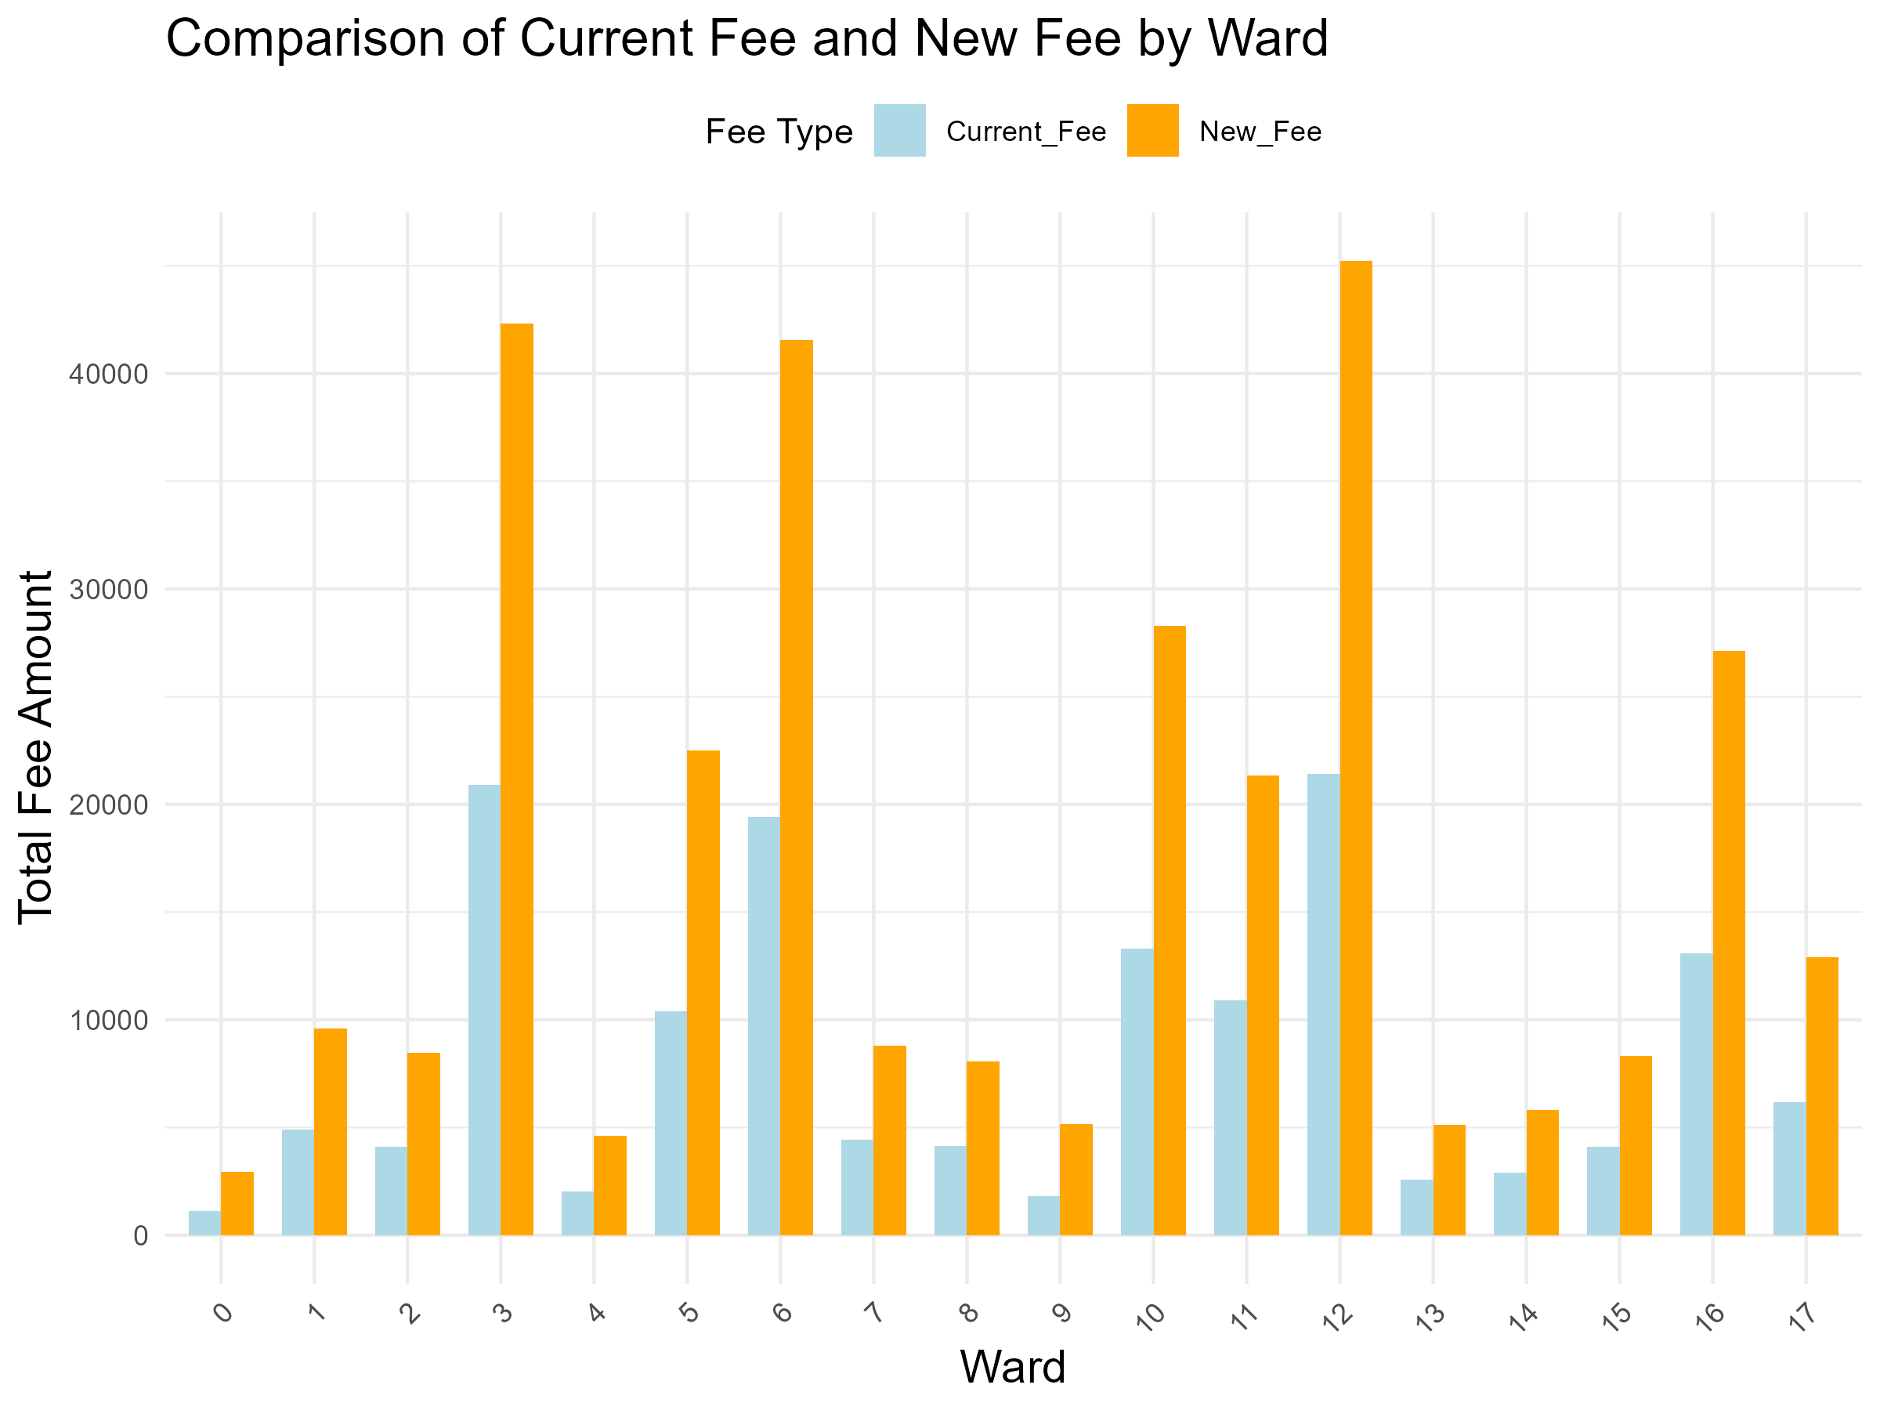
Preliminary Comparison of Revised Fee Structure

Slide 23
Questions?
10 Minutes

Slide 24
5. Emission Reduction and Mitigation Activities
Proposed Rule (New)
Collected fees may be used for grants to facilities to upgrade their equipment
Collected fees may be used as grants for local businesses and community groups demonstrating a project that reduces emissions and/or mitigate the impact of air pollution
Why it matters
Will assist facilities managing the financial cost in upgrading their equipment
Funds communities that are impacted by air pollution and provides an opportunity for community members to identify solutions that are unique to their neighborhoods
Draft Code Section: §263.01 Fees for Permits, Notifications and Variances

Slide 25
6. Formally establish an Indoor Air Quality Program
Proposed Rule (New)
Formally authorizes CDAQ's ability to enter a home with invitations by resident and provides recommendations on how to improve indoor air quality conditions
Establishes an in-home assessment process to provide recommendations to residents
Why it matters
The indoor environment can have 2-5x more pollutants than outdoor air
Indoor air quality complaints are among the top concerns expressed by residents
Expands CDAQ's ability to provide resources for community members
Draft Code Section: §268 Indoor Air Quality Program

Slide 26
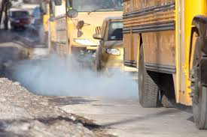
7. Vehicle Idling
Proposed Rule (New)
Industry and businesses must ensure vehicles on their property follow the existing City of Cleveland Anti-Idling Ordinance
Why it matters
Vehicle emissions are harmful to health, impact quality of life, and contribution to Cleveland-Cuyahoga County not meeting federal rules.
Common concern/complaint submitted by residents
Draft Code Section: §277.05 Vehicle Emissions

Slide 27
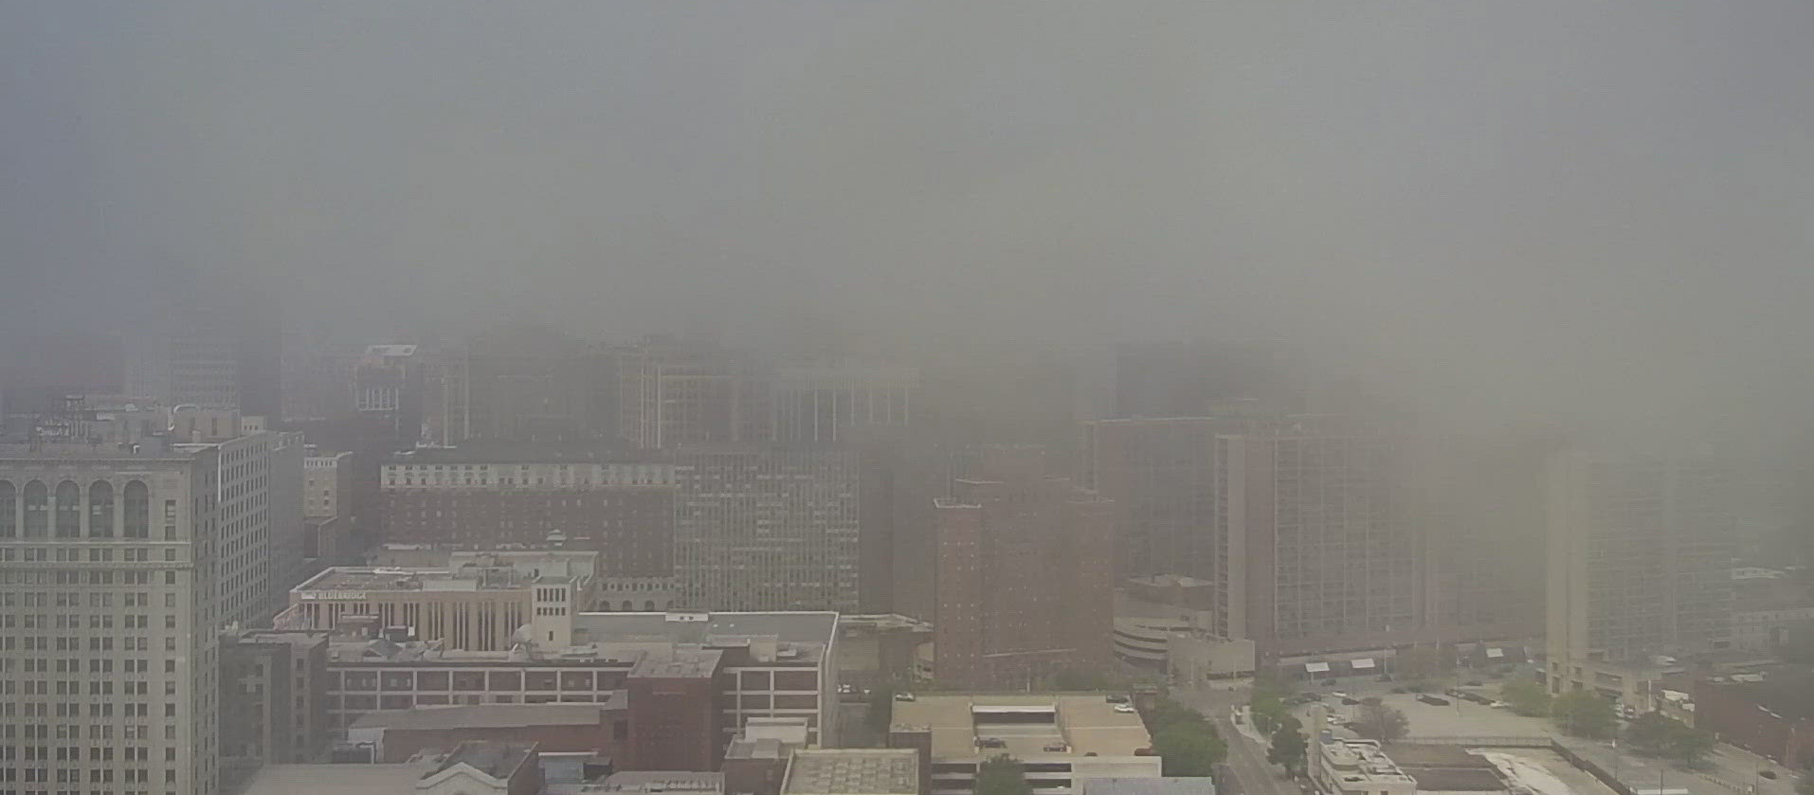
8. Emergency Episodes
Proposed Rule (New)
Requires all City Departments to develop action plans for when air quality levels exceed certain thresholds
Plans will include employee training and communication plans
Why it matters
Ensures that City operations do their part in reducing impact during poor air quality days
Draft Code Section: §283 Emergency Episodes

Slide 28
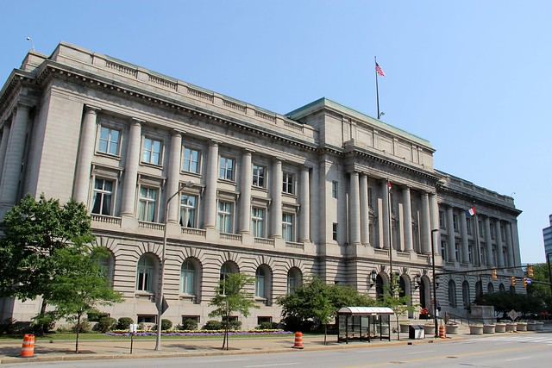
Submitting Comment and Next Steps
Comments must be submitted by 2/17/25:
Provide written comment tonight on the provided forms
Call (216) 420-8049
Visit www.clevelandhealth.org and complete the online form
Next Steps
CDAQ will review comments and incorporate feedback
A revised code will be submitted to Cleveland City Council in early March
Stakeholders will have an additional opportunity to submit comment during the legislative process

Slide 29
Questions and Comments?

Slide 30
Thank you!
David Hearne, Commissioner (216) 664- 2178 | dhearne@clevelandohio.gov​
Christina Yoka, Chief of Air Pollution Outreach ​ (216) 664- 2129 | cyoka@clevelandohio.gov​
Yvette Mitchell, Environmental Program Manager
(216) 664- 4181 | ymitchell@clevelandohio.gov​
Submit Comments:
www.clevelandhealth.org

